Slide 1
Graphene Devices for Beyond-CMOS Heterogeneous Integration
Mohamed Darwish

Slide 2
Outline
Neuromorphic Computing
Cellular Neural Network
Reconfigurable-Mux Logic
RG Mux Logic and Graphene Diodes
Graphene Neurons and Synapses
Device-Aware Synthesis
Interesting Graphene Properties
Beyond-CMOS Systems
Beyond-CMOS, More Moore and More than Moore
Layers of Design Abstraction
Why we need more communication
Relation between Mobility and Charged-Impurity Concentration
Strain Evolution during Graphene FET Fabrication
Co-Optimization of Thermal and Electrical properties of Graphene-Metal contacts

Slide 3
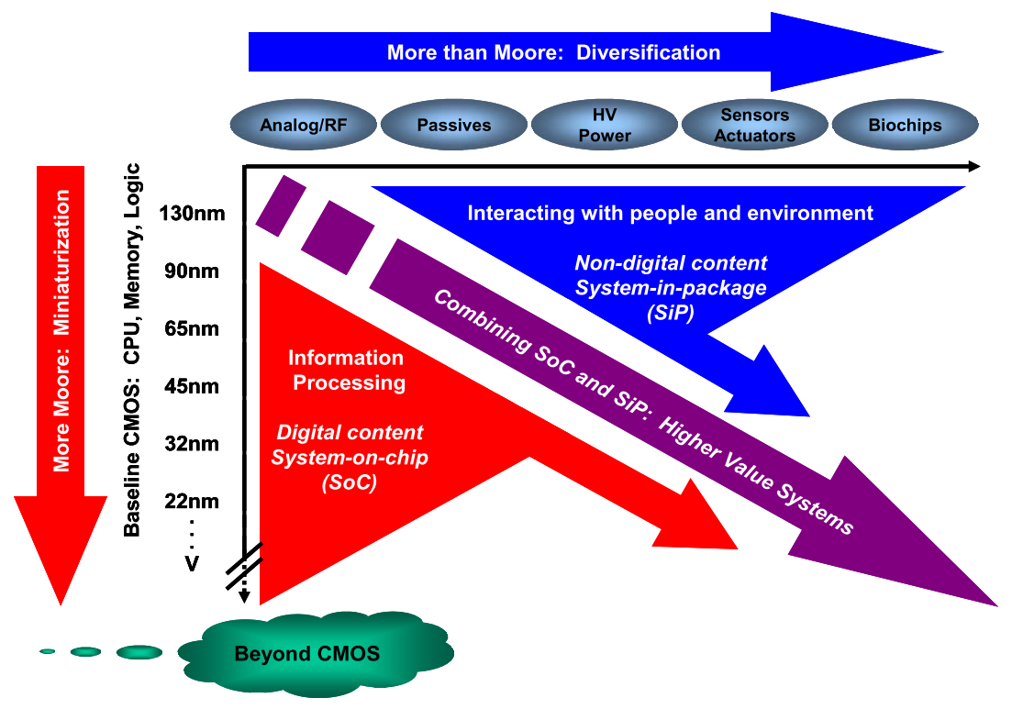
What’s next on the Roadmap?
Beyond-CMOS
Graphene CNN
RG Mux Logic
Graphene Properties
W. Arden, M. Brillouët, P. Cogez, M. Graef, B. Huizing, and R. Mahnkopf, “‘More-than-Moore’ White Paper.”

Slide 4
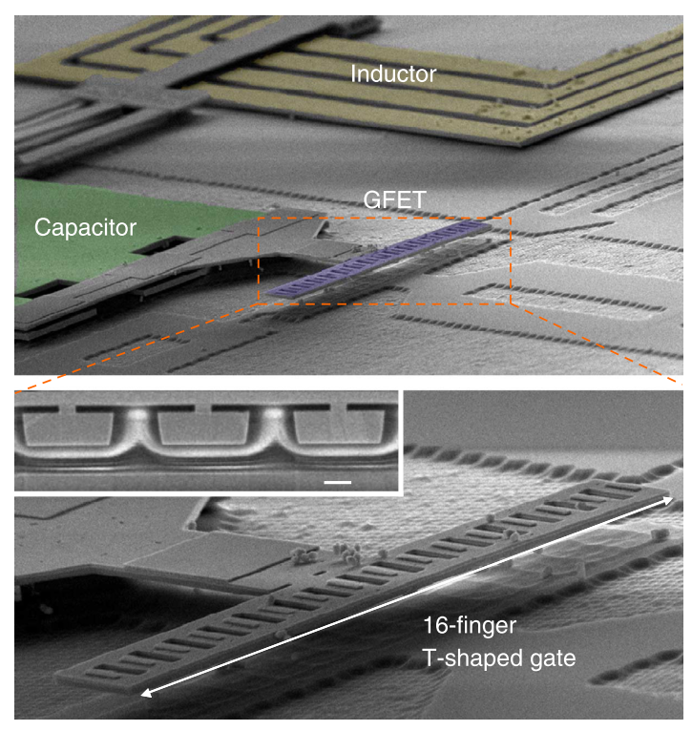
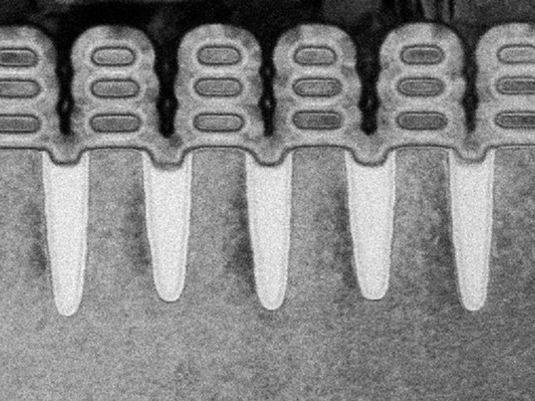
Beyond-CMOS, More Moore and More than Moore
Beyond-CMOS
Graphene CNN
RG Mux Logic
Graphene Properties
IBM
S.-J. Han, A. V. Garcia, S. Oida, K. A. Jenkins, and W. Haensch, “Graphene radio frequency receiver integrated circuit,” Nat. Commun., vol. 5, pp. 1–6, Jan. 2014.

Slide 5
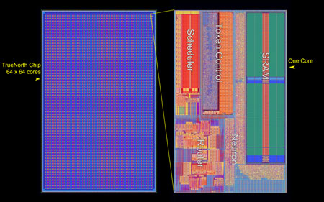
TrueNorth: Architecture Innovation
Beyond-CMOS
Graphene CNN
RG Mux Logic
Graphene Properties
IBM

Slide 6
New Architecture and Device Paradigms
Beyond-CMOS
Graphene CNN
RG Mux Logic
Graphene Properties
Architecture
Quantum
Neuromorphic
Information Processing
Device-Aware Synthesizers
Stochastic Computing
Error-Prone Computing
Device
2D FET
CNT
Tunnel FET
Spintronic
GpnJ
Magnetic

Slide 7
We Need Paradigm Shifts
Beyond-CMOS
Graphene CNN
RG Mux Logic
Graphene Properties
System Architecture
Module
Gate/Circuit
Device
System
Circuit
Device

Slide 8
Why the paradigm shift?
Beyond-CMOS
Graphene CNN
RG Mux Logic
Graphene Properties
Neural Networks have been very successful in classification and image processing problems
One circuit-friendly implementation (Cellular Neural Networks) have been around since the 1980s
CNN implementation are size limited
Excessive power consumption limits the number of cells
L. O. Chua and L. Yang, “Cellular neural networks: theory,” IEEE Trans. Circuits Syst., vol. 35, no. 10, pp. 1257–1272, 1988.

Slide 9
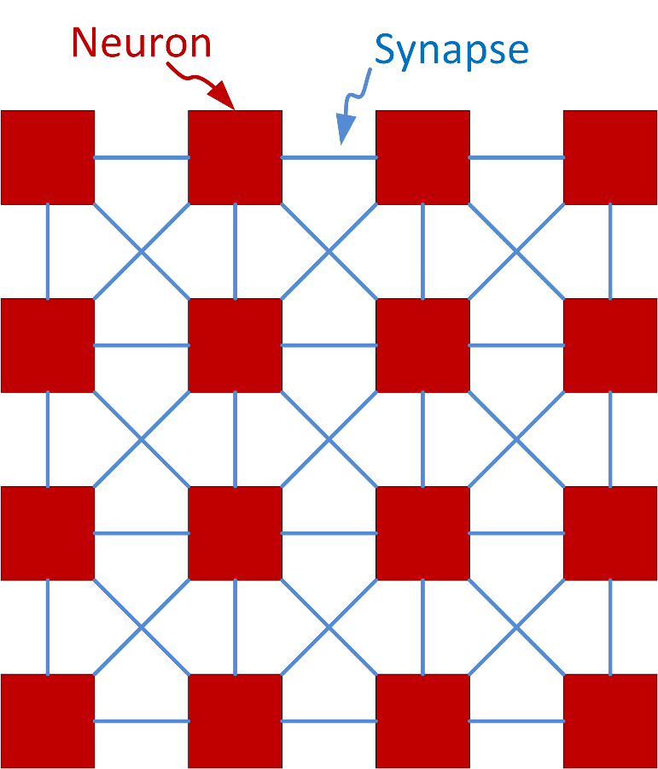
Cellular Neural Networks - Architecture
Beyond-CMOS
Graphene CNN
RG Mux Logic
Graphene Properties
4x4 CNN
L. O. Chua and L. Yang, “Cellular neural networks: theory,” IEEE Trans. Circuits Syst., vol. 35, no. 10, pp. 1257–1272, 1988.

Slide 10
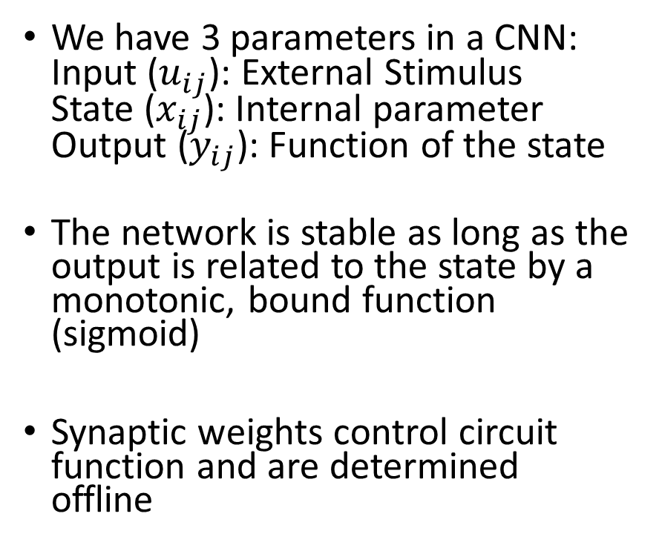
Cellular Neural Networks – System Model
Beyond-CMOS
Graphene CNN
RG Mux Logic
Graphene Properties
We have 3 parameters in a CNN: Input ($u_{ij}$): External Stimulus State ($x_{ij}$): Internal parameter Output ($y_{ij}$): Function of the state
The network is stable as long as the output is related to the state by a monotonic, bound function (sigmoid)
Synaptic weights control circuit function and are determined offline
L. O. Chua and L. Yang, “Cellular neural networks: theory,” IEEE Trans. Circuits Syst., vol. 35, no. 10, pp. 1257–1272, 1988.

Slide 11
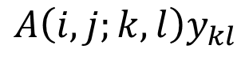
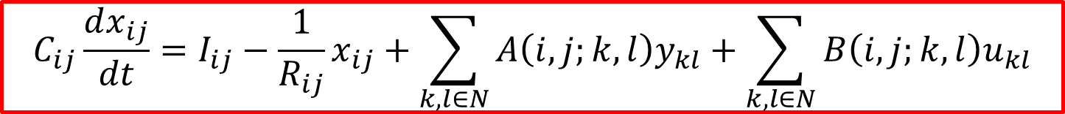
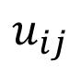
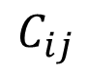
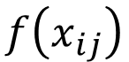
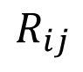
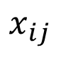
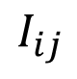
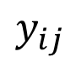
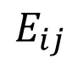
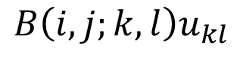
Cellular Neural Networks – Neuron Circuit Model
Beyond-CMOS
Graphene CNN
RG Mux Logic
Graphene Properties
$$u_{ij}$$
$$x_{ij}$$
$$y_{ij}$$
$$A\left(i,j;k,l\right)y_{kl}$$
$$B\left(i,j;k,l\right)u_{kl}$$
$$f\left(x_{ij}\right)$$
$$E_{ij}$$
$$I_{ij}$$
$$R_{ij}$$
$$C_{ij}$$
Input
Stimulus
State Variable
Output Sigmoid
$$C_{ij}\frac{dx_{ij}}{dt}=I_{ij}−\frac{1}{R_{ij}}x_{ij}+\sum_{k,l∈N}{A\left(i,j;k,l\right)y_{kl}}+\sum_{k,l∈N}{B\left(i,j;k,l\right)u_{kl}}$$
L. O. Chua and L. Yang, “Cellular neural networks: theory,” IEEE Trans. Circuits Syst., vol. 35, no. 10, pp. 1257–1272, 1988.

Slide 12
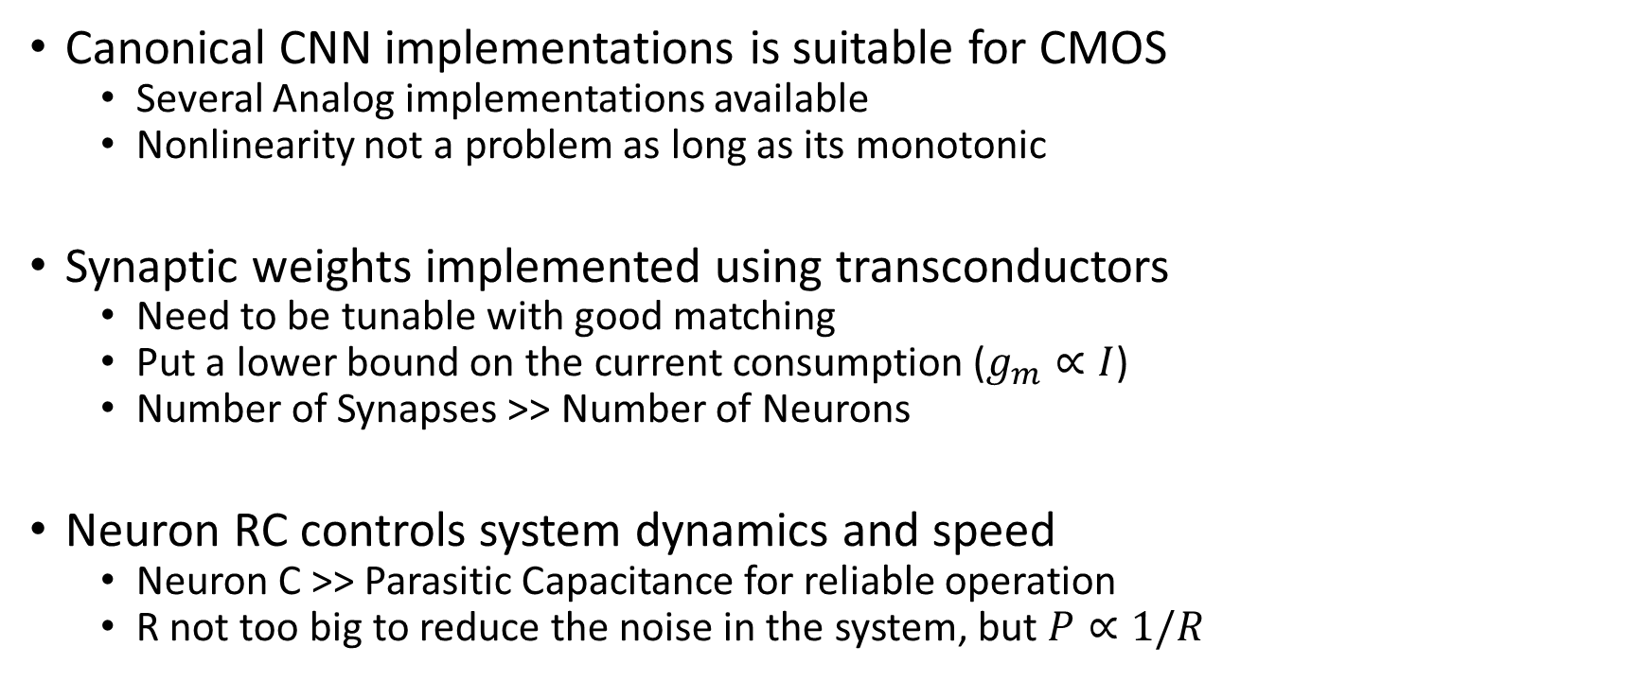
CMOS implementation of Canonical CNN
Beyond-CMOS
Graphene CNN
RG Mux Logic
Graphene Properties
Canonical CNN implementations is suitable for CMOS
Several Analog implementations available
Nonlinearity not a problem as long as its monotonic
Synaptic weights implemented using transconductors
Need to be tunable with good matching
Put a lower bound on the current consumption ($g_{m}∝I$)
Number of Synapses >> Number of Neurons
Neuron RC controls system dynamics and speed
Neuron C >> Parasitic Capacitance for reliable operation
R not too big to reduce the noise in the system, but $P∝1/R$

Slide 13
Problems of CMOS CNN
Beyond-CMOS
Graphene CNN
RG Mux Logic
Graphene Properties
Power Consumption
Dominated by Synapse Transconductors
Large number of Synapses
Matching and Tuning Requirements
Synapse Transconductance needs to be tunable
Synapses must be well matched
Speed Limitations
Neuron C >> Parasitics for Robustness
Lower RC means more power consumption

Slide 14
What can graphene do?
Beyond-CMOS
Graphene CNN
RG Mux Logic
Graphene Properties
Graphene provides variable, finite channel resistance
Voltage controlled resistor or low output resistance transistor
CVD graphene allow us to create high density of devices
Graphene is compatible with CMOS
Allows leveraging the high memory density available in CMOS

Slide 15
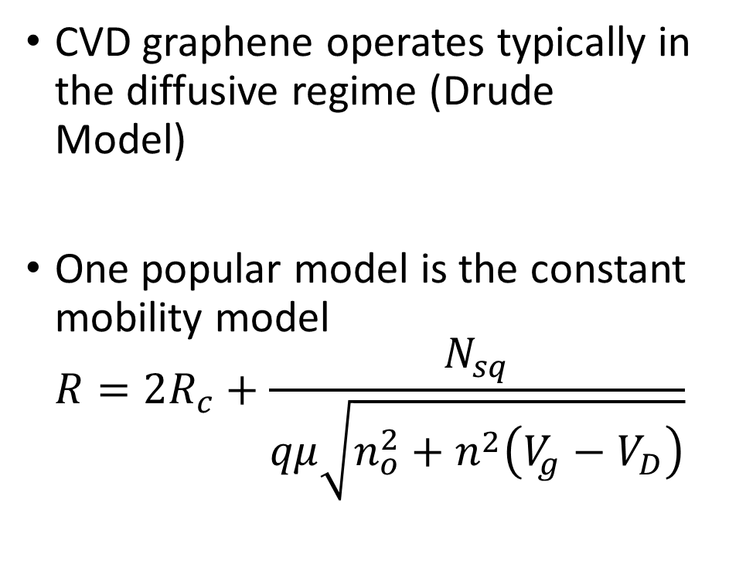
Graphene Resistance vs Gate Voltage
Beyond-CMOS
Graphene CNN
RG Mux Logic
Graphene Properties
CVD graphene operates typically in the diffusive regime (Drude Model)
One popular model is the constant mobility model $R=2R_{c}+\frac{N_{sq}}{qμ\sqrt{n_{o}^{2}+n^{2}\left(V_{g}−V_{D}\right)}}$

Slide 16
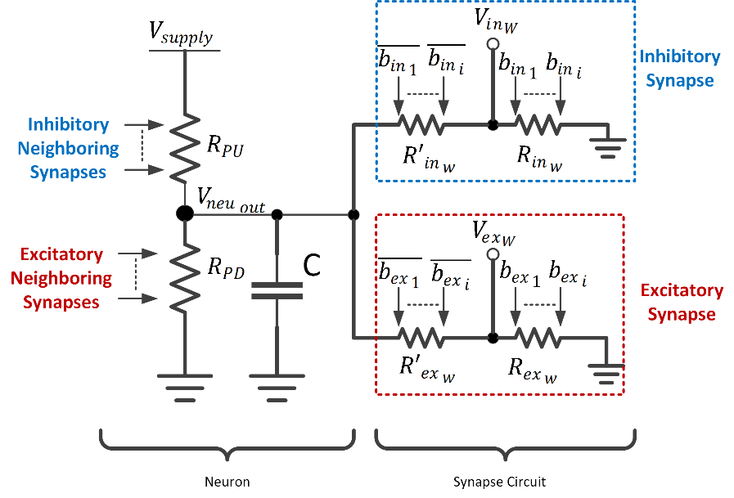
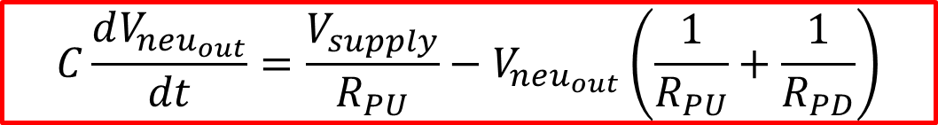
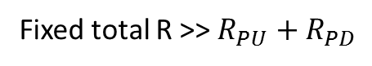
All-Graphene CNN - Architecture
Beyond-CMOS
Graphene CNN
RG Mux Logic
Graphene Properties
Fixed total R >> $R_{PU}+R_{PD}$
$$C\frac{dV_{neu_{out}}}{dt}=\frac{V_{supply}}{R_{PU}}−V_{neu_{out}}\left(\frac{1}{R_{PU}}+\frac{1}{R_{PD}}\right)$$
M. Darwish, V. Calayir, L. Pileggi, and J. A. Weldon, “Ultracompact Graphene Multigate Variable Resistor for Neuromorphic Computing,” IEEE Trans. Nanotechnol., vol. 15, no. 2, pp. 318–327, Mar. 2016.

Slide 17
All-Graphene CNN – Architecture Properties
Beyond-CMOS
Graphene CNN
RG Mux Logic
Graphene Properties
Neurons formed by a string of two voltage controlled resistors
Inhibitory/Excitatory resistors pull towards ground/supply respectively
Neuron Capacitor stores the state
Synapses formed via two complementary digitally-controlled resistors
Scales the output of the neuron before applying it to the inhibitory/excitatory control of the neighbor neuron
Both neurons and synapses formed via dual-gates graphene FETs

Slide 18
All-Graphene CNN – Architecture Properties
Beyond-CMOS
Graphene CNN
RG Mux Logic
Graphene Properties
Pros
Cons
Implicit sigmoidal behavior.
Synapse power consumption can be made arbitrarily small.
Reduced parasitic capacitance at state variable node.
Synapse matching required locally not globally.
Neuron RC limits speed.
More complicated training.
Network size limited by gate strength.

Slide 19
Neuron/Synapse: Device Structure
Beyond-CMOS
Graphene CNN
RG Mux Logic
Graphene Properties
$$R\left(V_{1},V_{2},…,V_{n},V_{bg}\right)=ρ\left(V_{bg}\right)\frac{L_{u}}{W_{u}}+\sum_{i=1 }^{n}{ρ\left(V_{i},V_{bg}\right)\frac{L_{i}}{W}+\frac{R_{T}\left(V_{i},V_{bg}\right)}{W}}$$
M. Darwish, V. Calayir, L. Pileggi, and J. A. Weldon, “Ultracompact Graphene Multigate Variable Resistor for Neuromorphic Computing,” IEEE Trans. Nanotechnol., vol. 15, no. 2, pp. 318–327, Mar. 2016.

Slide 20
Notable Fabrication Details
Beyond-CMOS
Graphene CNN
RG Mux Logic
Graphene Properties
Contacts cannot be sputtered to prevent damage to graphene
Evaporation causes no kinetic impact damage unlike sputtering
Top gate oxide require a seed as non-functionalized ALD precursors do not react with the graphene surface and preferentially react with reactive graphene edges
Top gate oxide ALD relieves stress developed during contacting, etching and seed layer deposition (more on this later)

Slide 21
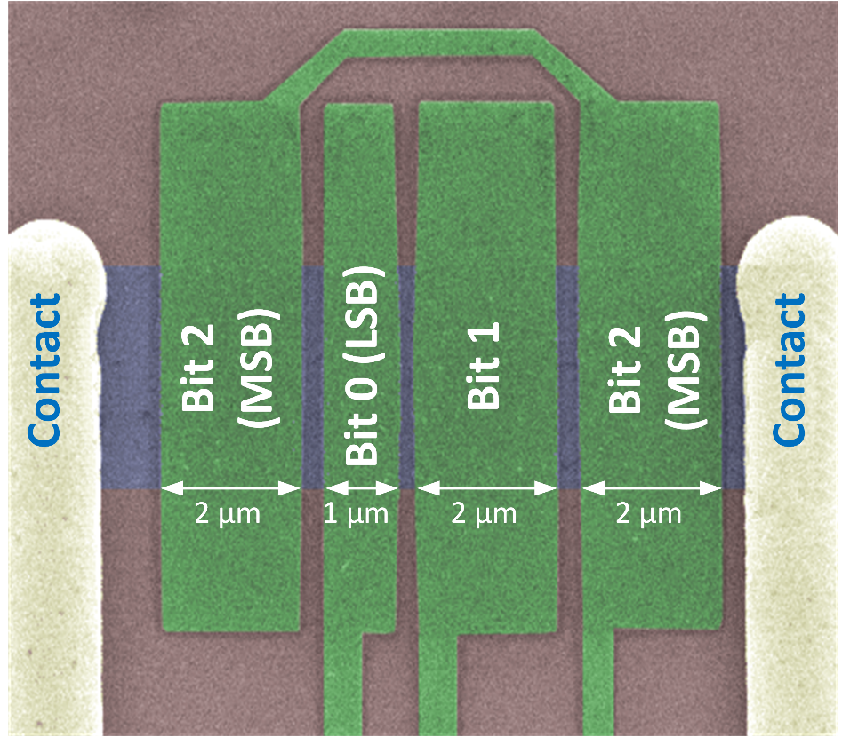
Neuron/Synapse: How they look like
Beyond-CMOS
Graphene CNN
RG Mux Logic
Graphene Properties
3-input Neuron
3-bit Synapse

Slide 22
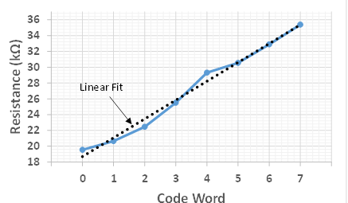
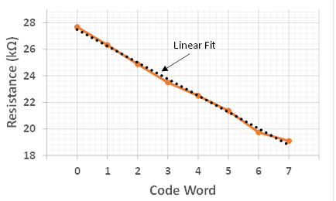
Interesting Synapse Behavior
Beyond-CMOS
Graphene CNN
RG Mux Logic
Graphene Properties
V_{BG}>V_{D}
V_{BG}<V_{D}

Slide 23
Synapse as Dual-Slope Digital-to-Resistance Converter
Beyond-CMOS
Graphene CNN
RG Mux Logic
Graphene Properties

Slide 24
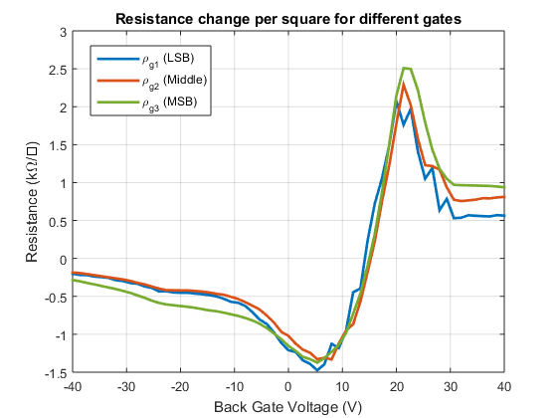
Measured Synapse Resistance Change
Beyond-CMOS
Graphene CNN
RG Mux Logic
Graphene Properties
Expected
Measured

Slide 25
Synapses as Digital-to-Resistance Converter
Beyond-CMOS
Graphene CNN
RG Mux Logic
Graphene Properties
Synapses act as Digital-to-Resistance Converter
Slope and magnitude of resistance change controlled by back gate voltage
Process variability reduced using CMOS-like techniques (ex. Common centroid)

Slide 26
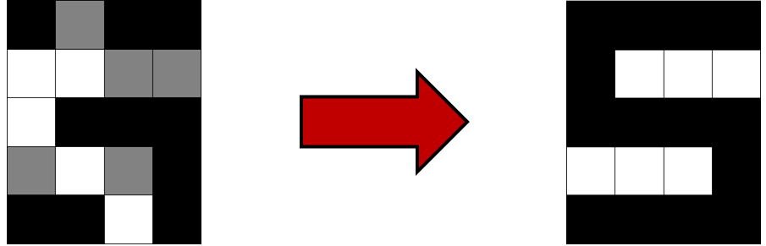
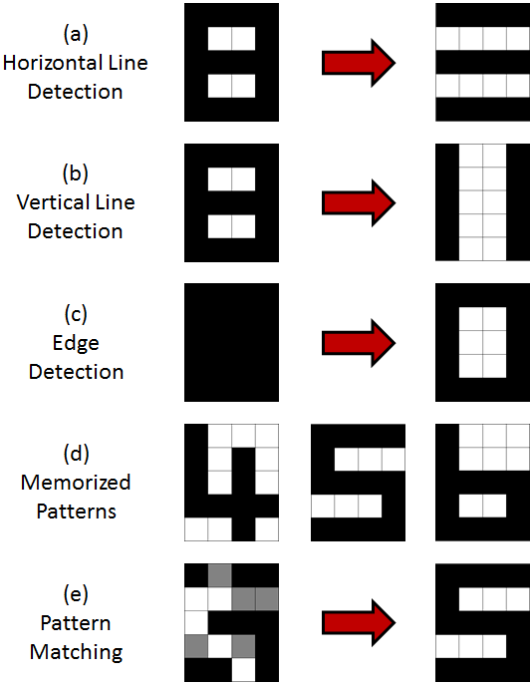
System-Level VerilogA Simulation
Beyond-CMOS
Graphene CNN
RG Mux Logic
Graphene Properties
VerilogA models developed based on measurement results
Classification trained using Hebbian learning offline and successful up to 28% distortion
System can also perform edge and line detection

Slide 27
What All-Graphene CNNs taught us
Beyond-CMOS
Graphene CNN
RG Mux Logic
Graphene Properties
System-Circuit-Device co-design allows the custom design of architectures that leverage the characteristics of devices to enhance overall system performance considerably
Device-Architecture co-design can help alleviate critical implementation limitations
Communication among different domains is crucial

Slide 28
A review of graphene diodes
Linear dispersion and continuum of states except at the Dirac point make graphene diodes attractive
Lossless as there is no barrier potential
Relies on optics-inspired techniques for conduction anisotropy
Can be used for low-loss scavenging of RF power or diode-based mux logic

Slide 29
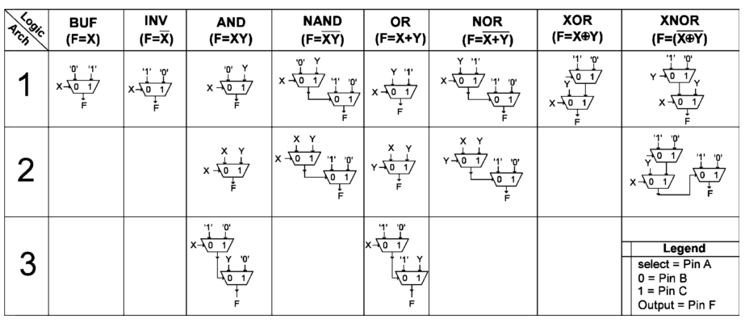
Mux Logic
Beyond-CMOS
Graphene CNN
RG Mux Logic
Graphene Properties
S. Miryala et al., “Delay model for reconfigurable logic gates based on graphene PN-junctions,” in Proceedings of the 23rd ACM international conference on Great lakes symposium on VLSI - GLSVLSI ’13, 2013, vol. 2, no. 1, p. 227.

Slide 30
How to implement graphene diodes
Geometric diodes proposed to achieve asymmetric conduction by collimation of charge carriers in one direction and not the other
Fabricated using exfoliated and CVD graphene
Exfoliated graphene devices always had higher asymmetry
Hints to the role of scattering
Maximum achieved asymmetry was ~1.37 using exfoliated graphene

Slide 31
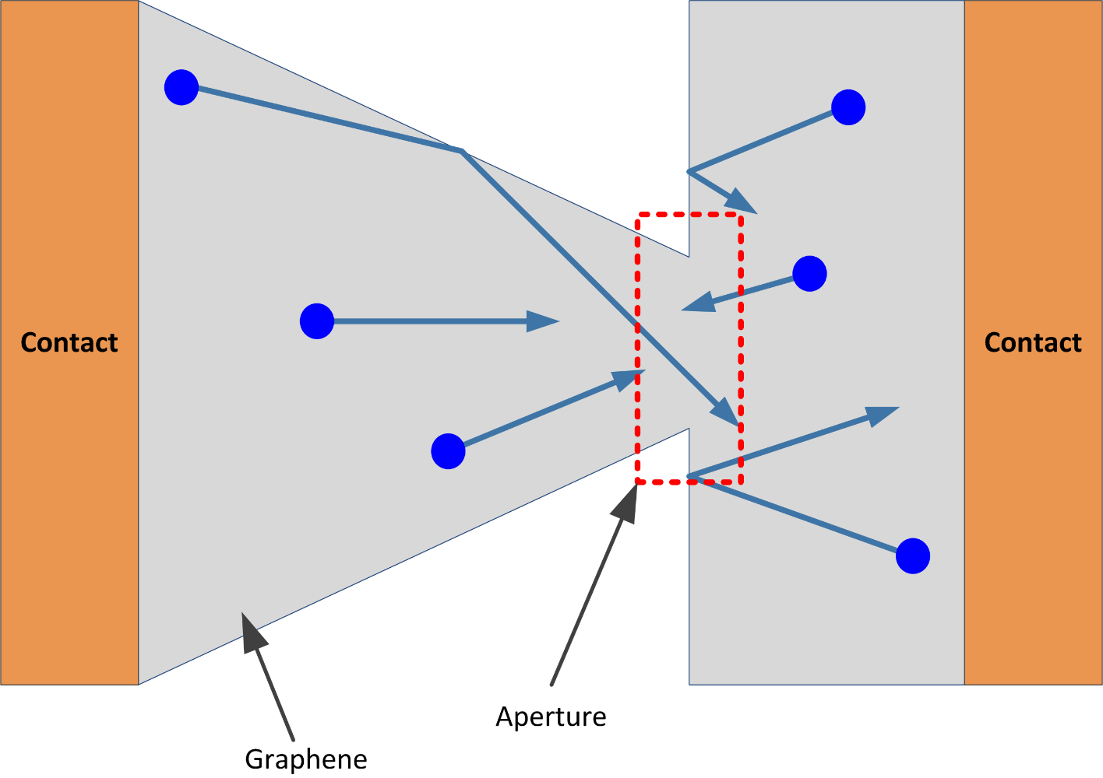
Principle of operation of geometric diodes

Slide 32
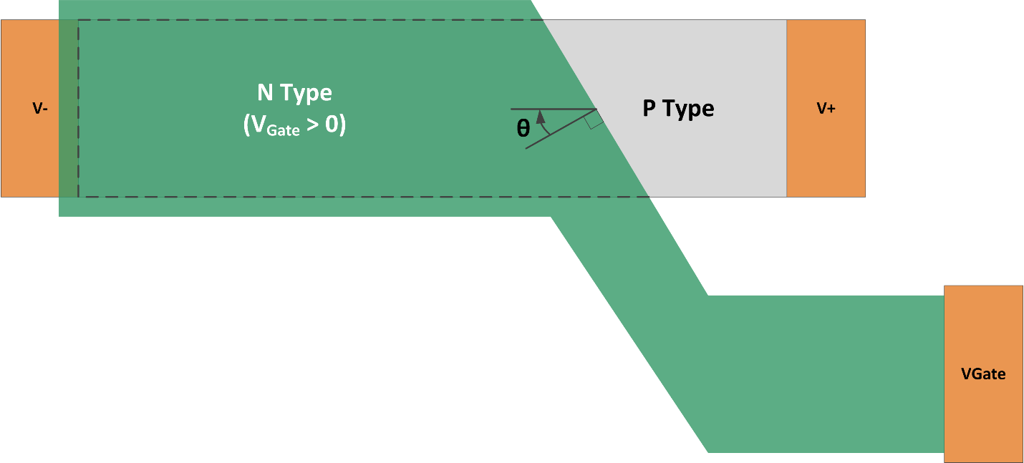
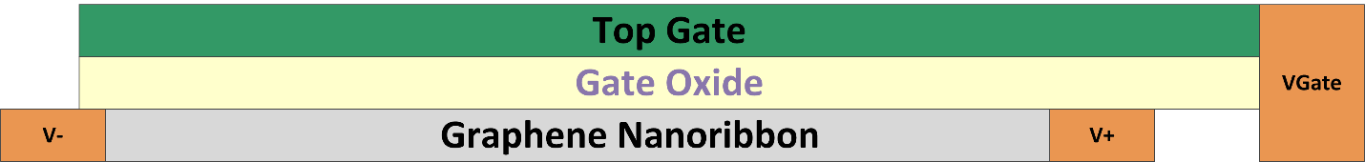
Proposed Oblique Incidence diode

Slide 33
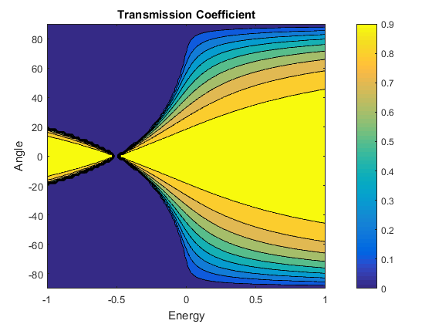
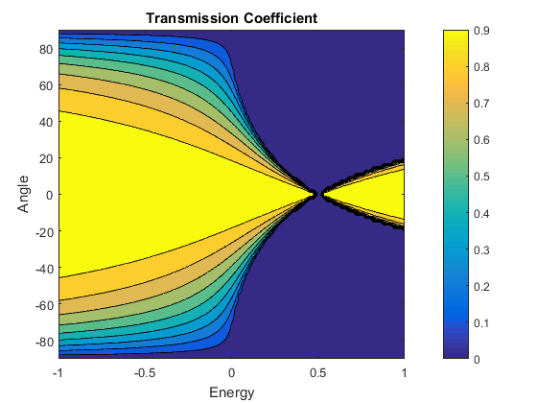
Interface Transmission Asymmetry
Left-to-Right
Right-to-Right
E₁ = 0.5 eV, E₂ =-0.5eV

Slide 34
Oblique PN junction model
Beyond-CMOS
Graphene CNN
RG Mux Logic
Graphene Properties
Scattering smears the angular distribution and limits the backward-to-forward resistance ratio

Slide 35
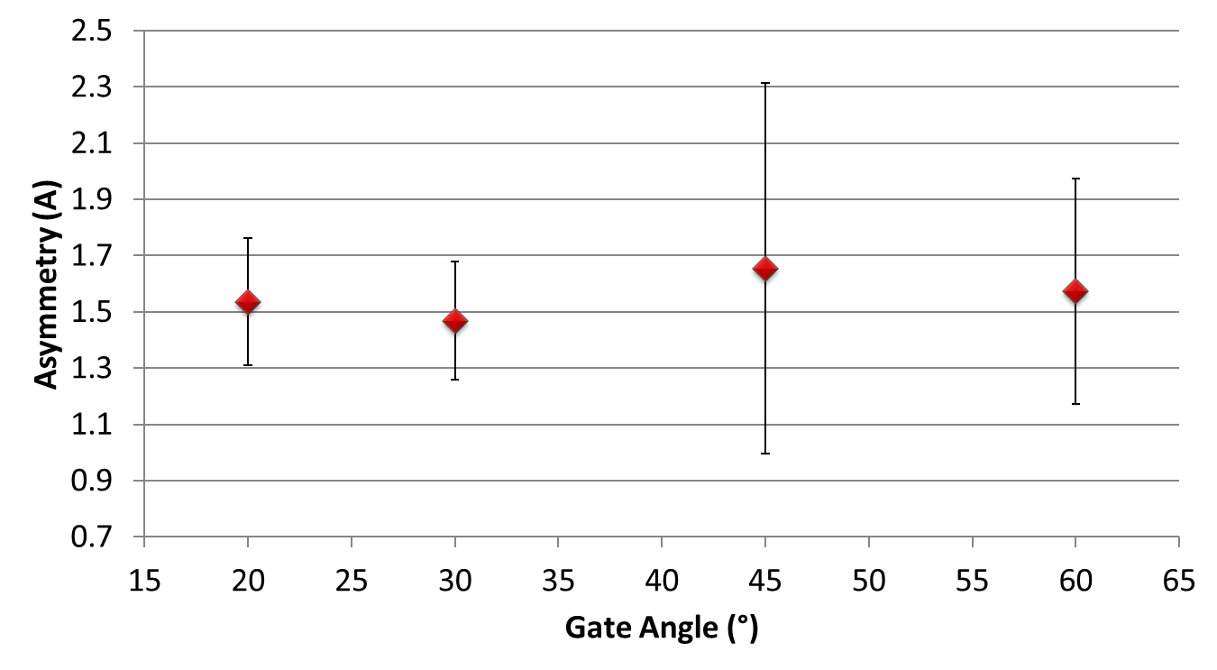
Measurement Results
Beyond-CMOS
Graphene CNN
RG Mux Logic
Graphene Properties
A = I(V_{FWD})/I(V_{BWD})
Highest Graphene Diode Asymmetry reported to date!

Slide 36
Results from Diode Measurements

Slide 37
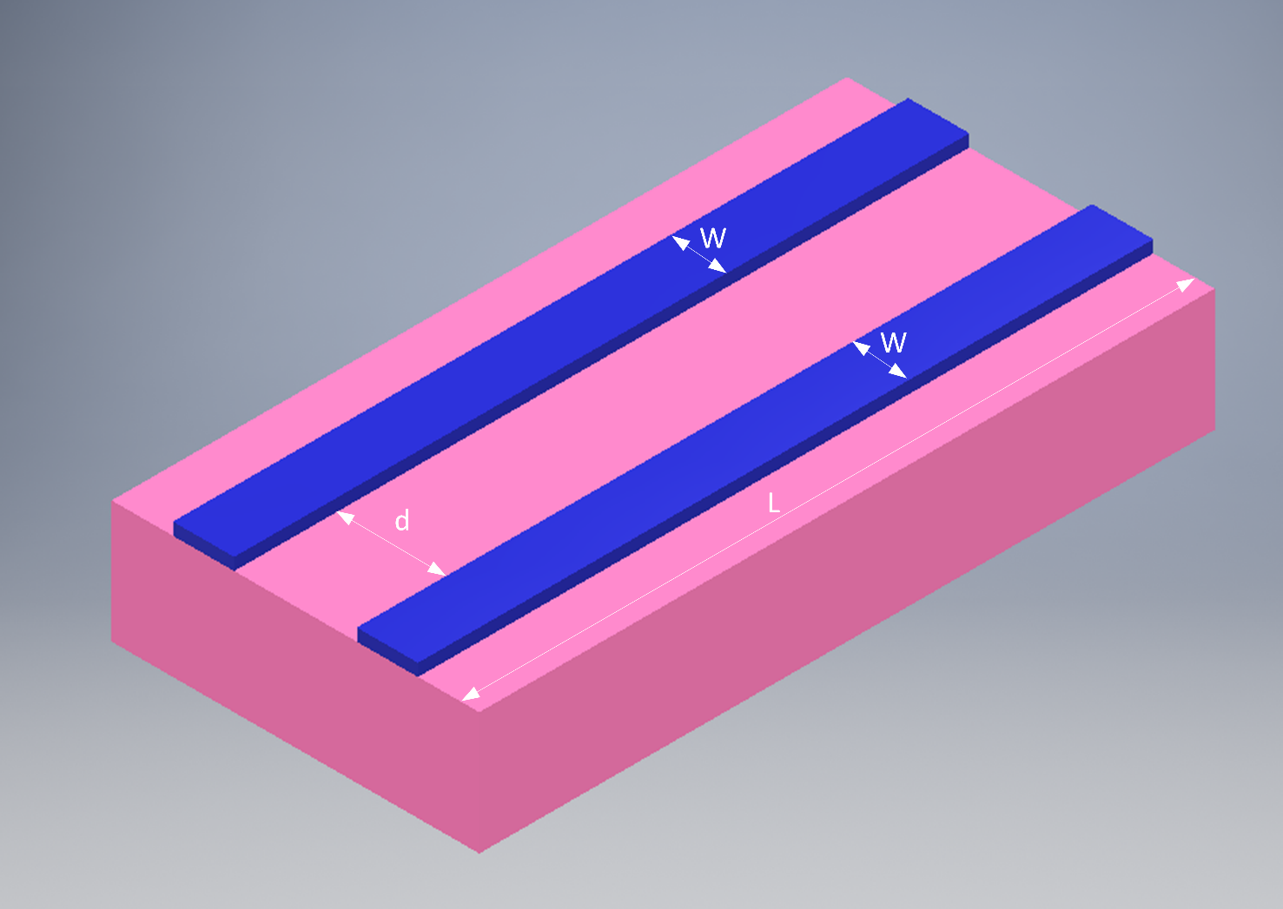
Graphene Coupler

Slide 38
Why study resistive coupling?
Ballistic-transport devices predicted to have periodic coupling coefficient like their optics counterparts
Diffusive-transport couplers never studied
Could they be useful?
How does diffusive transport affect the coupling coefficient?
Capacitive coupling and cross-talk have been thoroughly investigated, but no study of scaling limits in terms of resistive coupling

Slide 39
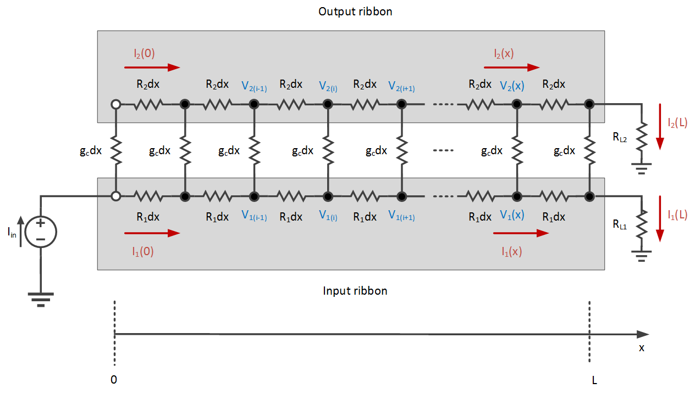
Electrical model of diffusive coupler

Slide 40
Electrical model details
Loss of phase information by scattering allows us to model coupling using a resistance
Sheet resistance of each branch assumed to be the same for simplicity
Process gradient can be assumed negligible if ribbons are not far apart
Charge-puddles average out macroscopically
Coupling conductance per unit length obtained via Bardeen Transfer Hamiltonian (BTH)

Slide 41
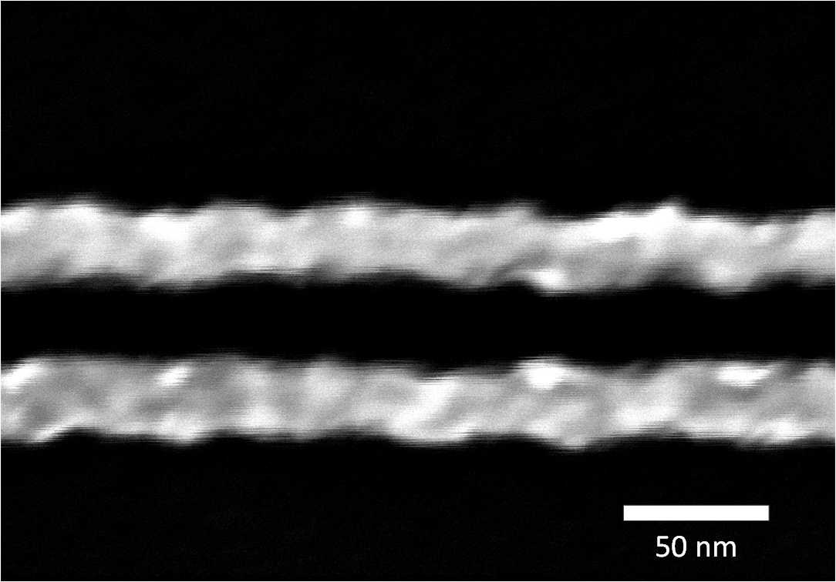
Is this model accurate?
Loss of phase information preserved
All distributed resistances should be random variables
Charge puddles and non-uniform process gradient in graphene ribbons
Line-Edge Roughness causes coupling conductance to be a random variable
Can be relaxed to first order models and when spacing is too wide for roughness to be significant

Slide 42
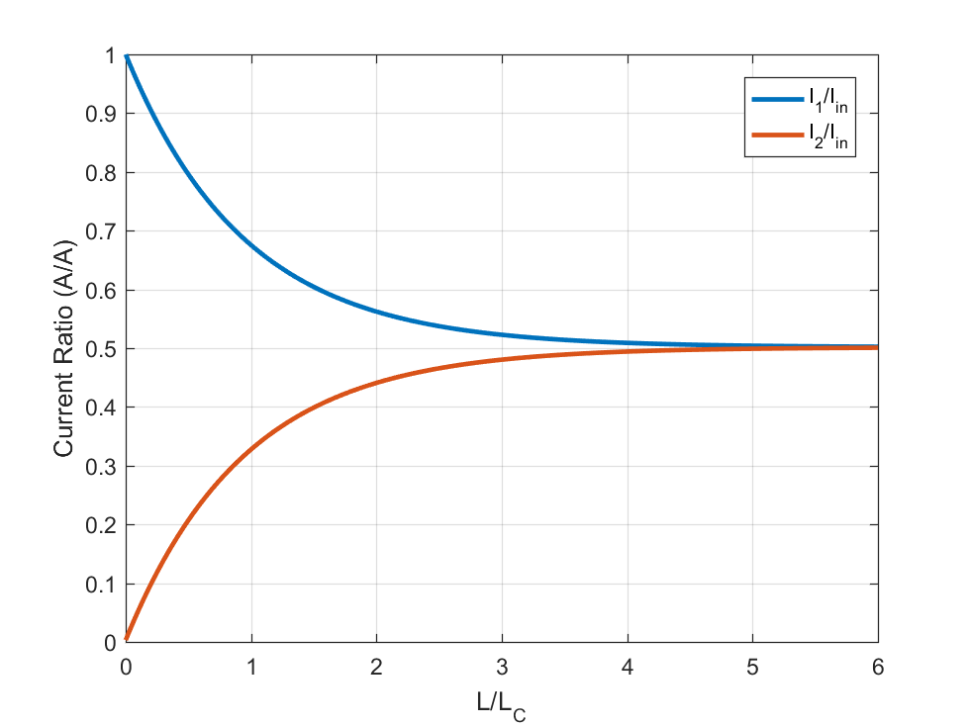
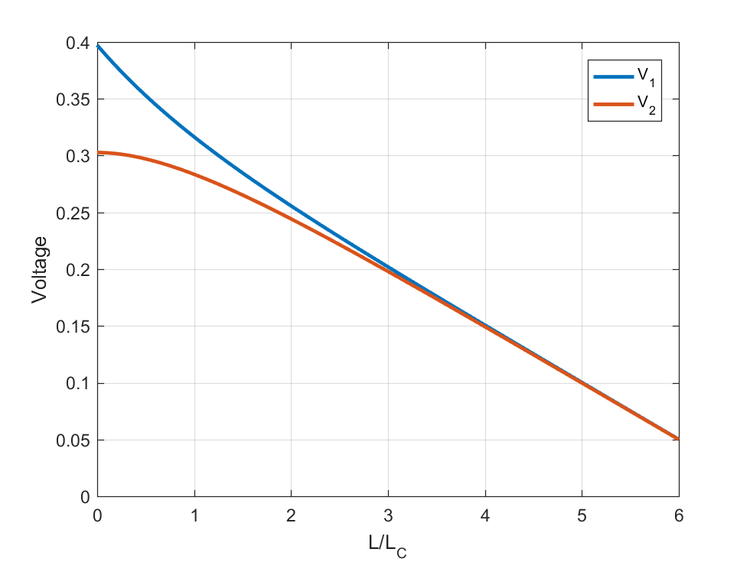
SPICE simulation results

Slide 43
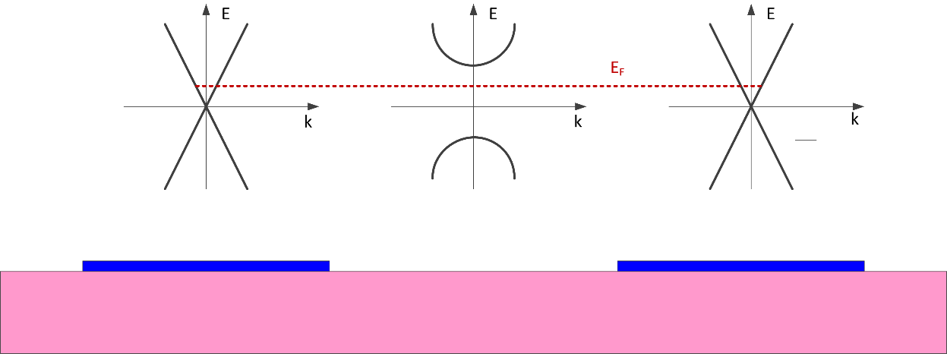
Coupling conductance estimation
Oxide is a parabolic bandstructure system between two graphene ribbons with linear band structure
Transmission coefficient has a very sharp angular dependence making an approximate 1D tunneling model accurate

Slide 44
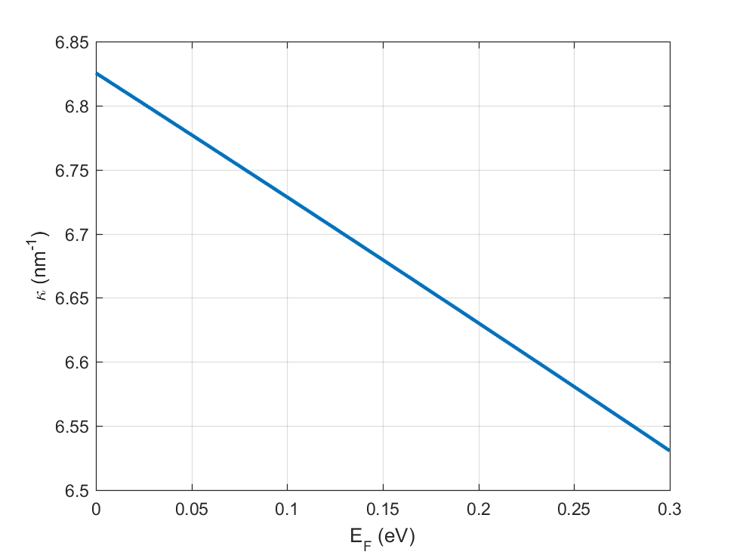
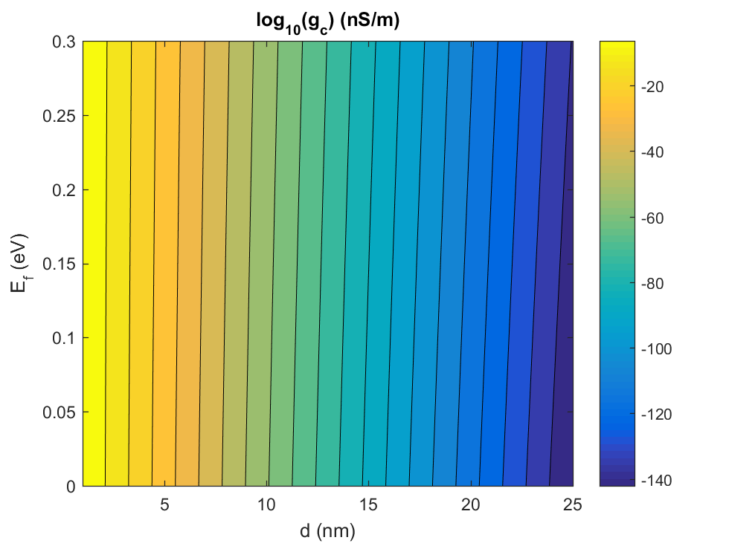
Coupling conductance results

Slide 45
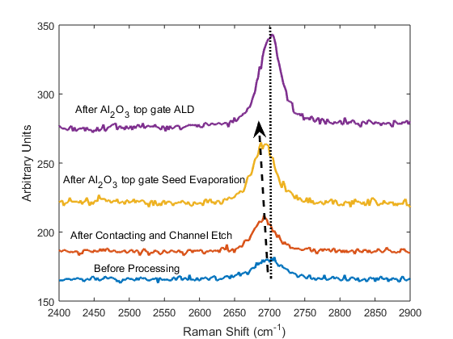
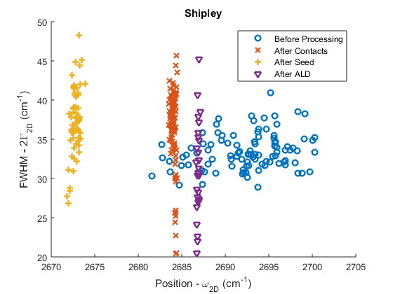
Strain Evolution during GFET Fabrication
Beyond-CMOS
Graphene CNN
RG Mux Logic
Graphene Properties
Blue Shift α Strain
M. Darwish, D. Saha, J. Malen, and J. A. Weldon, “Processing-Induced Strain in Dual-Gated Graphene FETs”, in IEEE Nano, 2017.

Slide 46
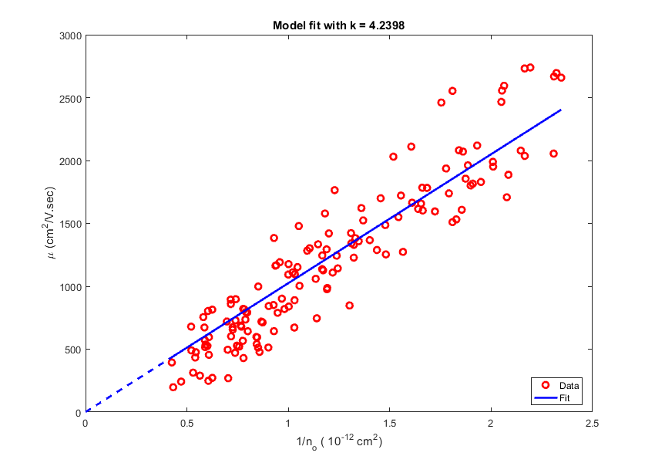
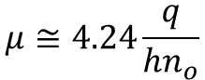
Mobility vs Charged-Impurity Concentration
Beyond-CMOS
Graphene CNN
RG Mux Logic
Graphene Properties
$$μ≅4.24\frac{q}{{hn}_{o}}$$
M. Darwish, D. Saha, J. Malen, and J. A. Weldon, “A Comparison of the Impact of Metal - Ion Containing and Metal - Ion Free Photoresist Developers on Graphene Field - Effect Transistors,” in IEEE Nano, 2017.

Slide 47
Co-Optimization of Thermal and Electrical properties of Graphene-Metal Contacts
Beyond-CMOS
Graphene CNN
RG Mux Logic
Graphene Properties
Joule heating increases channel temperature increasing scattering and reducing mobility
Proper device design enhances graphene-metal thermal contact allowing heat to escape through the contact reducing the channel heating
Thermal contact optimization should not affect electrical contact resistance to prevent reduction in electrical device performance
D. Saha, X. Yu, M. Darwish, M. Jeong, J. Freedman, A. Gellman, J. Weldon and J. Malen, “Developing Superior Alloy Contacts Optimized for Electrical and Thermal Transport at Metal-Graphene Interfaces”, MRS Spring, April 2017

Slide 48
Contact Metal Choice
Beyond-CMOS
Graphene CNN
RG Mux Logic
Graphene Properties
Ni and Pd are known to have the lowest electrical contact resistance to graphene
Compositionally Spread Alloy Film (CSAF) or Ni-Pd was evaporated on a blanket graphene film over 90 thermal SiO2 and graphene-metal interface thermal conductance (G_{TH}) was evaluated FDTR (Frequency Dependent Thermal Reflectance)
All sample covered with Au transducer layer
Higher thermal interface conductance is desirable as it means more heat can flow across the metal contact rather than through the channel
D. Saha, X. Yu, M. Darwish, M. Jeong, J. Freedman, A. Gellman, J. Weldon and J. Malen, “Developing Superior Alloy Contacts Optimized for Electrical and Thermal Transport at Metal-Graphene Interfaces”, MRS Spring, April 2017

Slide 49
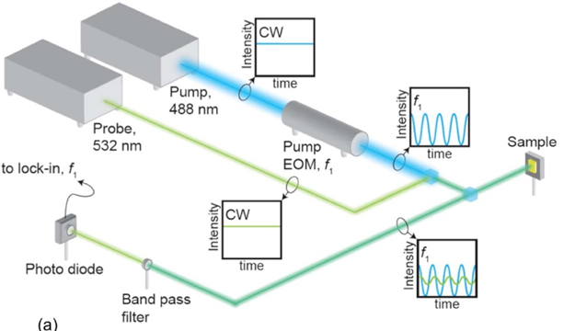
FDTR
Beyond-CMOS
Graphene CNN
RG Mux Logic
Graphene Properties
J. Epstein, W. L. Ong, C. J. Bettinger, and J. A. Malen, “Temperature Dependent Thermal Conductivity and Thermal Interface Resistance of Pentacene Thin Films with Varying Morphology,” ACS Appl. Mater. Interfaces, vol. 8, no. 29, pp. 19168–19174, 2016.

Slide 50
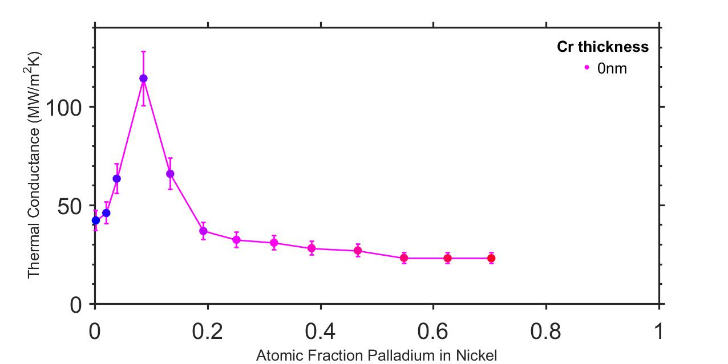
Evaluated Metal-Graphene G_{TH}
Beyond-CMOS
Graphene CNN
RG Mux Logic
Graphene Properties
Elemental metals lie in this range
D. Saha, X. Yu, M. Darwish, M. Jeong, J. Freedman, A. Gellman, J. Weldon and J. Malen, “Developing Superior Alloy Contacts Optimized for Electrical and Thermal Transport at Metal-Graphene Interfaces”, MRS Spring, April 2017

Slide 51
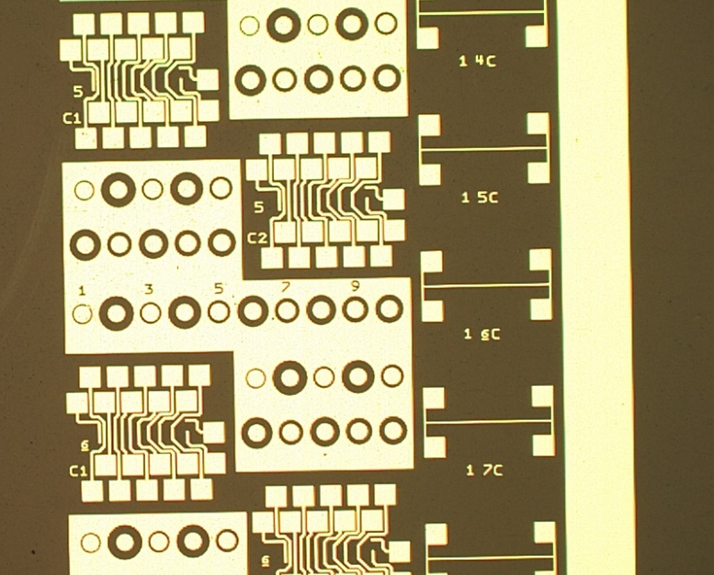
Electrical Measurements
Beyond-CMOS
Graphene CNN
RG Mux Logic
Graphene Properties
Currently another CSAF sample is being created with electrical and thermal measurements structures
Electrical: Linear TLM, Circular TLM, CBKR and 4-point probe
Thermal: Metal strips
Will the electrical contact resistance show the same trend?

Slide 52
Conclusion

Slide 53

Questions?

Slide 54
Fabrication Steps (1): Contact photolithography
Beyond-CMOS
Graphene CNN
RG Mux Logic
Graphene Properties
(a) Positive photoresist (S1805) and lift-off layer (LOR3A) spin and bake
(b) Exposure and development in CD26 (TMAH-based MIF developer prevents graphene doping)

Slide 55

Fabrication Steps (1): Contact photolithography
Beyond-CMOS
Graphene CNN
RG Mux Logic
Graphene Properties

Slide 56
Fabrication Steps (2): Contact deposition and lift-off
Beyond-CMOS
Graphene CNN
RG Mux Logic
Graphene Properties
(a) Evaporation of contact metal stack (Ti/Pd 1.5/40 nm at a rate < 0.3 Å/sec)
(b) Lift-off in a dedicated Microposit 1165 remover at 70 °C to prevent contamination

Slide 57

Fabrication Steps (2): Contact deposition and lift-off
Beyond-CMOS
Graphene CNN
RG Mux Logic
Graphene Properties

Slide 58
Fabrication Steps (3): Channel Etch Mask Photolithography
Beyond-CMOS
Graphene CNN
RG Mux Logic
Graphene Properties
(a) Positive photoresist (S1805) and lift-off layer (LOR3A) spin and bake
(b) Exposure and development in CD26 (TMAH-based MIF developer prevents graphene doping)

Slide 59
Fabrication Steps (4): Channel Definition using RIE
Beyond-CMOS
Graphene CNN
RG Mux Logic
Graphene Properties
(a) Etch the exposed graphene in O₂ plasma (20 W for 1 minute at 10 mTorr)
(b) Etch mask removal in a dedicated Microposit 1165 remover at 70 °C to prevent contamination

Slide 60

Fabrication Steps (3): Channel Etch Mask Photolithography
Beyond-CMOS
Graphene CNN
RG Mux Logic
Graphene Properties

Slide 61
Fabrication Steps (5): Top oxide seed layer and oxide deposition
Beyond-CMOS
Graphene CNN
RG Mux Logic
Graphene Properties
(a) Evaporation of 1.5 nm of Al to act as a seed layer for ALD as non-functionalized ALD reacts only with graphene edges. 1.5 nm of Al are fully oxidized in air (Native Al oxide is 2.5 nm thick)
(b) ALD of Al₂O₃ at 150 °C to finish the top gate oxide deposition

Slide 62
Fabrication Steps (6): Top gate e-beam lithography
Beyond-CMOS
Graphene CNN
RG Mux Logic
Graphene Properties
(a) Positive e-beam resist (PMMA A7) and spin and bake beyond glass transition temperature
(b) Exposure and development (1:3 MIBK:IPA developer) of top gate electrodes

Slide 63
Fabrication Steps (7): Top gate deposition
Beyond-CMOS
Graphene CNN
RG Mux Logic
Graphene Properties
(a) Evaporation of top gate metal
(b) Lift-off of top gate metal in a dedicated acetone bath

Slide 64

Fabrication Steps (7): Top gate deposition

